Slide 1
Introduction to Machine Learning

Slide 2
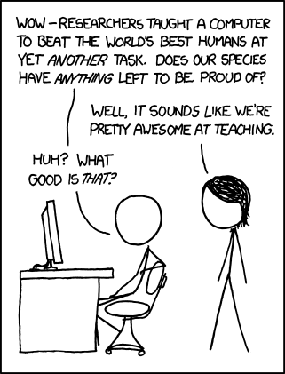
https://xkcd.com/894/

Slide 3
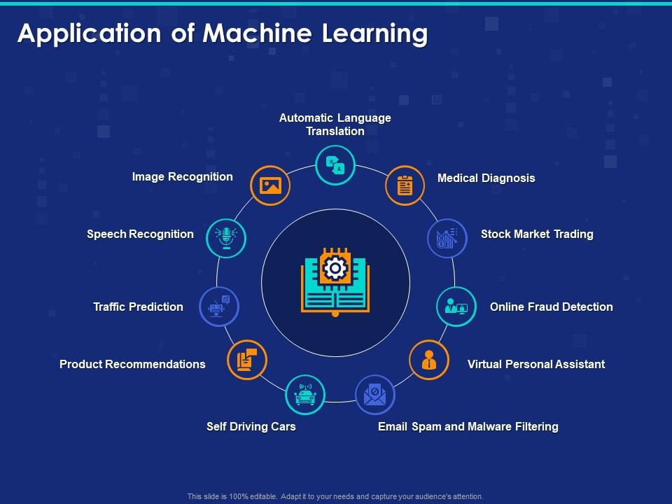

Slide 4
Why are you here?
What is Machine Learning?
Why are you taking this course?
What topics would you like to see covered?

Slide 5

Machine Learning is…
Machine learning is a subfield of computer science that evolved from the study of pattern recognition and computational learning theory in artificial intelligence.

Slide 6
Machine Learning is…
Machine learning is programming computers to optimize a performance criterion using example data or past experience.
-- Ethem Alpaydin
The goal of machine learning is to develop methods that can automatically detect patterns in data, and then to use the uncovered patterns to predict future data or other outcomes of interest.
-- Kevin P. Murphy
The field of pattern recognition is concerned with the automatic discovery of regularities in data through the use of computer algorithms and with the use of these regularities to take actions.
-- Christopher M. Bishop

Slide 7
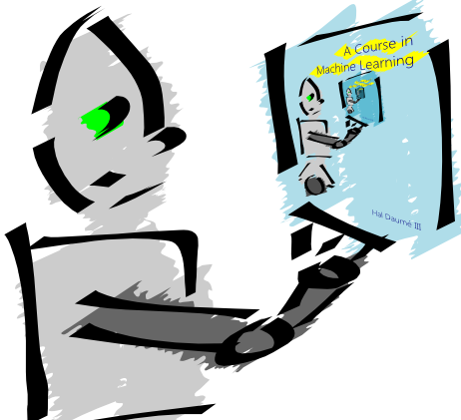
Machine Learning is…
Machine learning is about predicting the future based on the past.
-- Hal Daume III

Slide 8
Machine Learning is…
Machine learning is about predicting the future based on the past.
-- Hal Daume III
past
future
predict
learn
Training
Data
model/
predictor
Testing
Data
model/
predictor

Slide 9
Machine Learning, aka
data mining: data analysis, not prediction, though often involves some shared techniques
inference and/or estimation in statistics
pattern recognition in engineering
signal processing in electrical engineering
induction
optimization

Slide 10
Goals of the course: learn about…
Different machine learning problems
Common techniques/tools used
theoretical understanding
practical implementation
Proper experimentation and evaluation
Dealing with large (huge) data sets
Parallelization frameworks
Programming tools

Slide 11
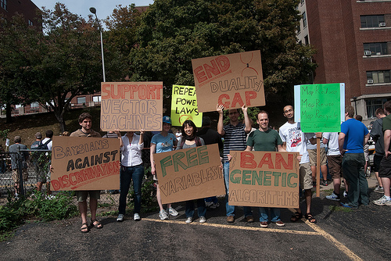
Goals of the course
Be able to laugh at these signs
(or at least know why one might…)

Slide 12
Course expectations
Plan to stay busy!
Applied class, so lots of programming
Machine learning involves math

Slide 13
Other things to note
Lots of class participation!
Read the book (it’s good)

Slide 14
Machine learning problems
What high-level machine learning problems have you seen or heard of before?

Slide 15
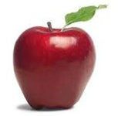
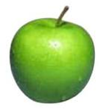
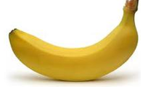
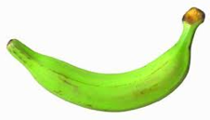
Data
examples
Data

Slide 16

Data
examples
Data

Slide 17

Data
examples
Data

Slide 18


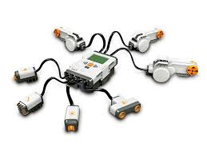
Data
examples
Data

Slide 19
Supervised learning
examples
label
label₁
label₃
labeled examples
label₄
label₅
Supervised learning: given labeled examples

Slide 20
Supervised learning
label
label₁
model/
predictor
label₃
label₄
label₅
Supervised learning: given labeled examples

Slide 21
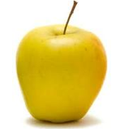
Supervised learning
model/
predictor
predicted label
Supervised learning: learn to predict new example

Slide 22
Supervised learning: classification
label
apple
Classification: a finite set of labels
apple
banana
banana
Supervised learning: given labeled examples

Slide 23
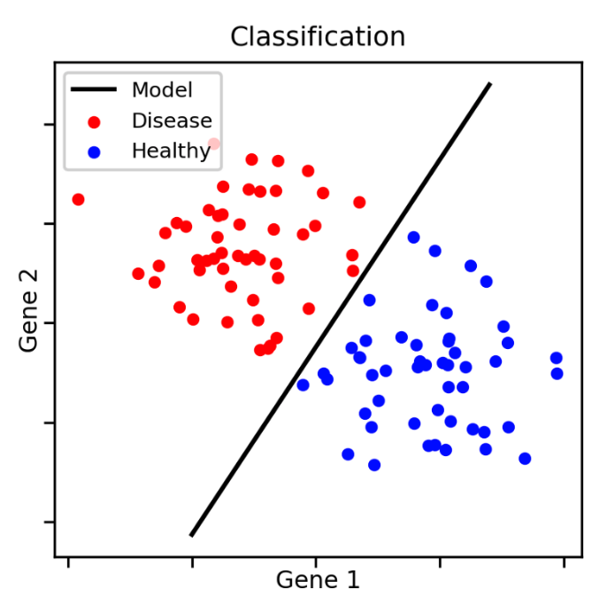
Classification Example

Slide 24
Classification Applications
Face recognition
Character recognition
Spam detection
Medical diagnosis: From symptoms to illnesses
Biometrics: Recognition/authentication using physical and/or behavioral characteristics: Face, iris, signature, etc
...

Slide 25
Supervised learning: regression
label
-4.5
Regression: label is real-valued
10.1
3.2
4.3
Supervised learning: given labeled examples

Slide 26
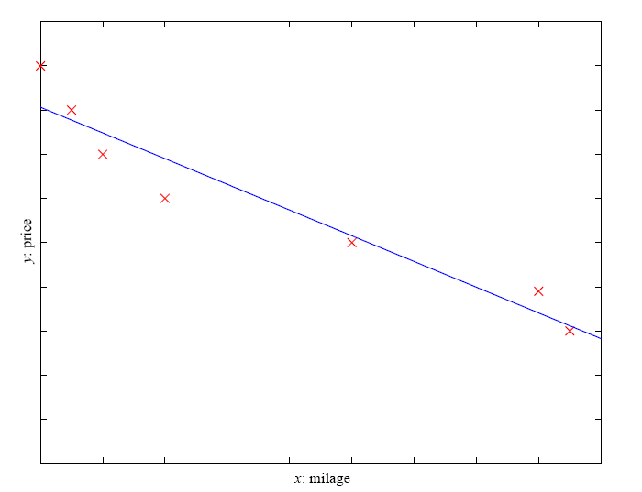
Regression Example
Price of a used car
x : car attributes (e.g. mileage)
y : price
y = wx+w₀

Slide 27
Regression Applications
Economics/Finance: predict the value of a stock
Epidemiology
Car/plane navigation: angle of the steering wheel, acceleration, …
Temporal trends: weather over time
…

Slide 28
Supervised learning: ranking
label
1
Ranking: label is a ranking
4
2
3
Supervised learning: given labeled examples

Slide 29
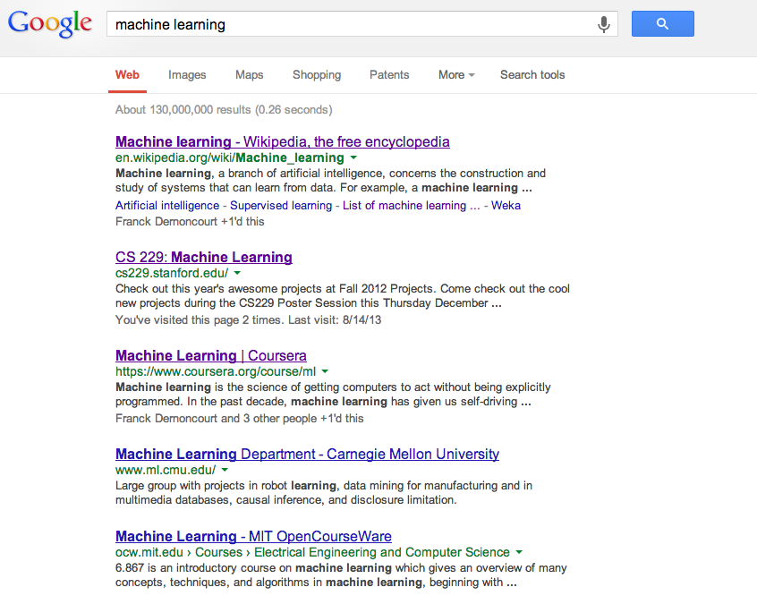
Ranking example
Given a query and
a set of web pages,
rank them according
to relevance

Slide 30
Ranking Applications
User preference, e.g. movie ranking
iTunes
flight search (search in general)
reranking N-best output lists
…

Slide 31
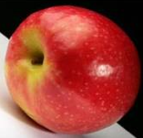
Unsupervised learning
Unupervised learning: given data, i.e. examples, but no labels

Slide 32
Unsupervised learning applications
learn clusters/groups without any label
customer segmentation (i.e. grouping)
image compression
bioinformatics: learn motifs
…

Slide 33
Reinforcement learning
left, right, straight, left, left, left, straight
GOOD
left, straight, straight, left, right, straight, straight
BAD
left, right, straight, left, left, left, straight
18.5
left, straight, straight, left, right, straight, straight
-3
Given a sequence of examples/states and a reward after completing that sequence, learn to predict the action to take for an individual example/state

Slide 34
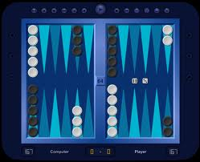
Reinforcement learning example
Backgammon
…
WIN!
…
LOSE!
Given sequences of moves and whether or not the player won at the end, learn to make good moves

Slide 35
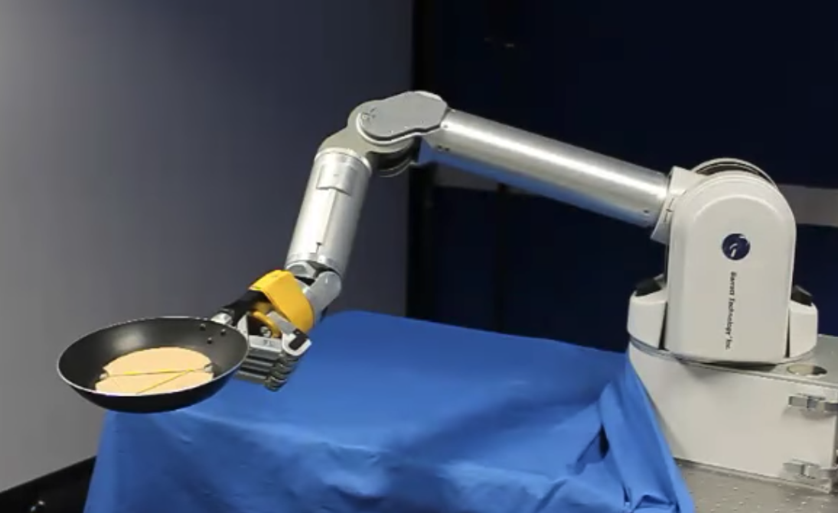
Reinforcement learning example
https://www.youtube.com/watch?v=W_gxLKSsSIE

Slide 36
Other learning variations
What data is available:
Supervised, unsupervised, reinforcement learning
semi-supervised, active learning, …
How are we getting the data:
online vs. offline learning
Type of model:
generative vs. discriminative
parametric vs. non-parametric

